Slide 1

Changing Pattern and Unusual Presentation
Of
Dengue Syndrome
Professor Quazi Tarikul Islam
FCPS, FRCP(Edin. Glasg.), MACP
Professor of Medicine
Editor in Chief
National Guideline for Clinical management
of Dengue Syndrome 2018

Slide 2
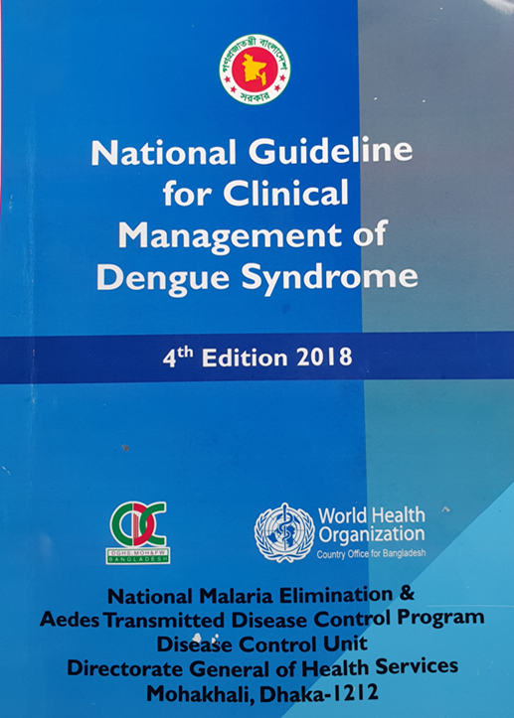
New guideline 2018

Slide 3
Dengue : South Asia
Philippines : 130,463 cases, 561 deaths as of 13 july, 2019
Malaysia: 75,913 cases, 111 deaths as of 27 july, 2019
Vietnam : 115,186 cases, 12 deaths as of 21 july, 2019
Thailand: 44,671 cases, 62 deaths as of 16 july, 2019
Singapore: 8020 cases as of 21 july, 2019
Sri lanka : 234,078 cases, 47 deaths as of 5 Aug, 2019
Source: CDC

Slide 4
The Philippines has declared 2019 a national dengue epidemic after 622 deaths -- CNN

Slide 5
Dengue: Bangladesh (1, January to 16, September 2019)
Health Emergency operation centre, DGHS
People affected by dengue
Released from hospitals
81839
79129

Slide 6
Dengue: Bangladesh (1 January to 16 September) 2019
Official death
68
Unofficial death
203

Slide 7
Dengue Cases over Years
(Source: National guideline for Clinical management of Dengue syndrome)

Slide 8
Dengue Cases over Years
(Source: National guideline for Clinical management of Dengue syndrome)

Slide 9
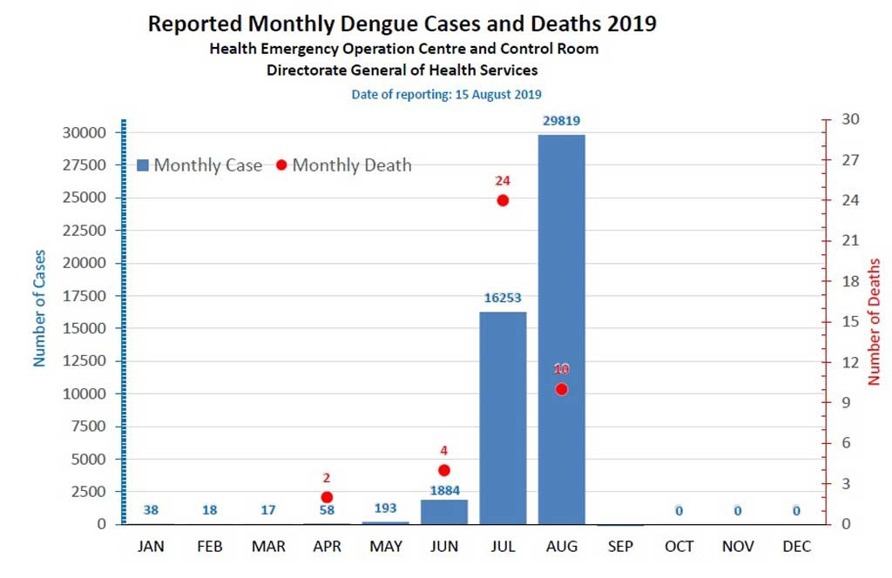

Slide 10
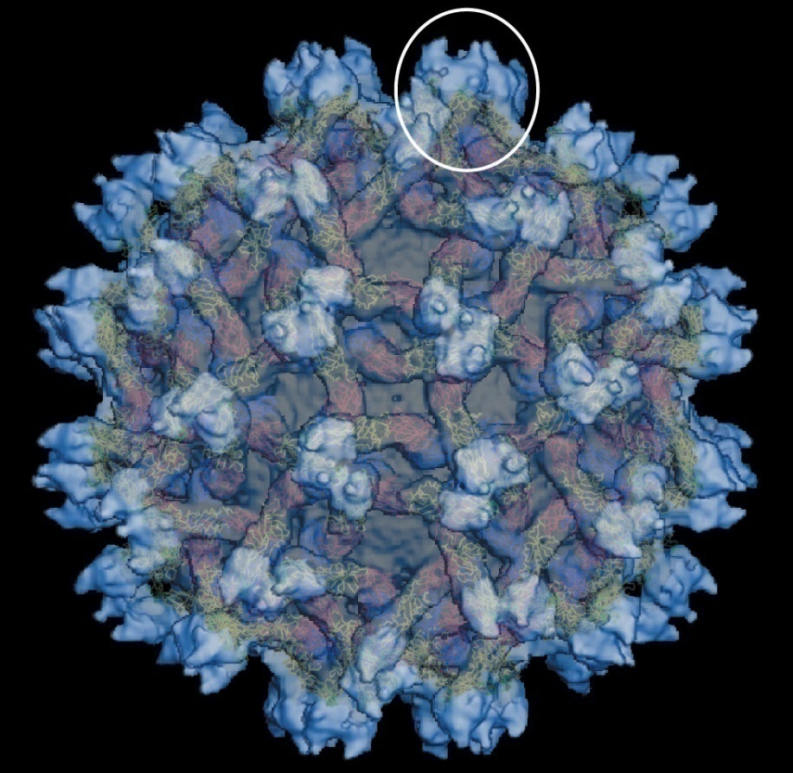
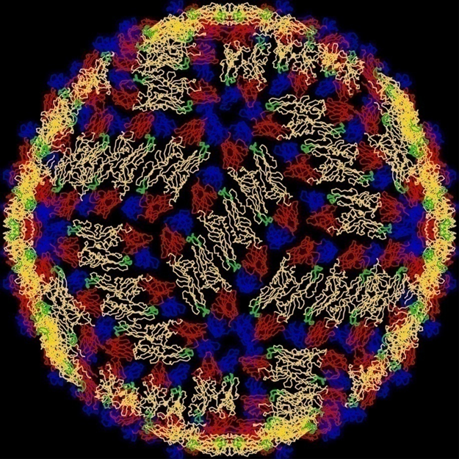
Responsible dengue viral particles

Slide 11
Tissue Tropism
Many cell types can be infected in vitro with DENV: monocytes, epithelial cells, endothelial cells, hepatocytes, myocytes.
Evidence of in vivo infection: presence of antigen, genome, active replication (negative viral RNA), in tissue samples.

Slide 13
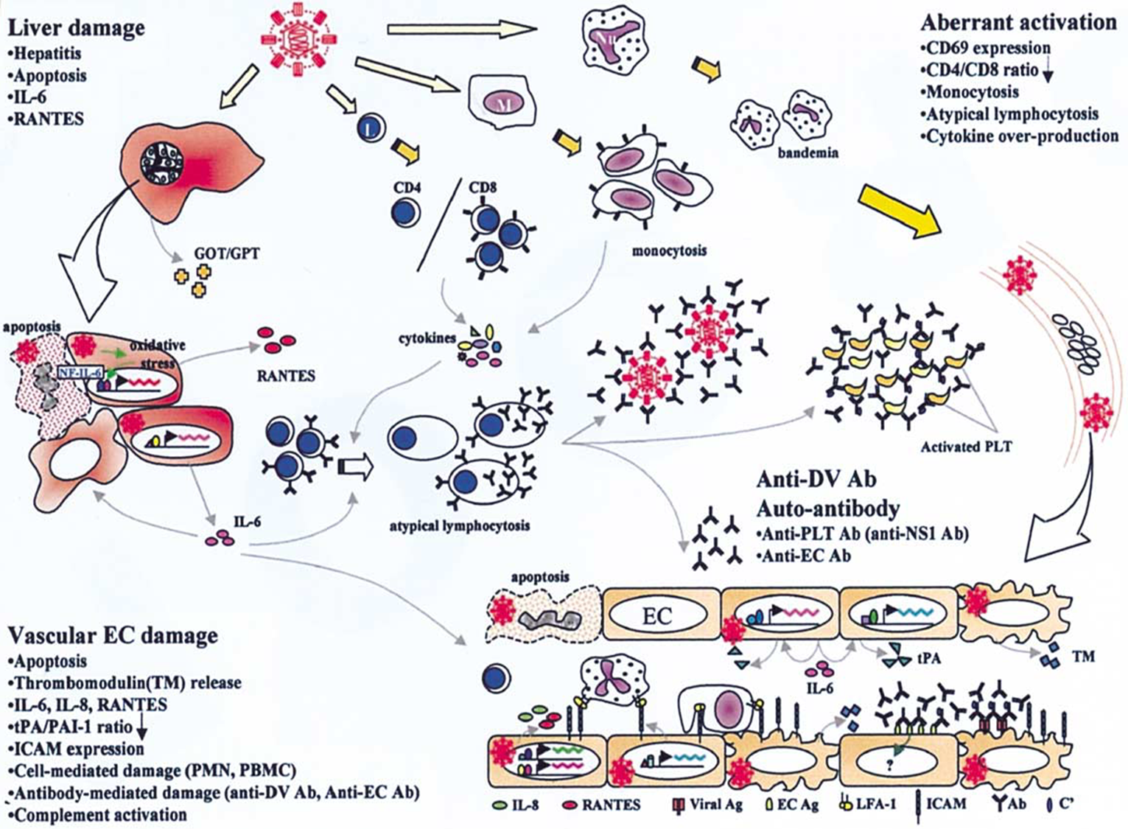

Slide 15
Why study pathogenesis?
To develop therapeutic interventions.
To develop predictive indicators or profiles of severe disease.
To identify protective and pathogenic immune correlates.

Slide 16
Evidence of Plasma leakage
Haematocrit (HCT) - With the leakage of plasma there will be increase in HCT. A 20% rise of HCT from the baseline is indicative of significant plasma leakage.
Plasma leakage is due to increased capillary permeability.
Plasma leakage in DHF is selective and transient and usually lasts for 24-48 hours.
Ascites and pleural effusion is the ultimate sequelle.

Slide 17
Evidence of Plasma leakage
Other evidence of plasma leakage are:
non-fasting serum cholesterol (<100 mg/dl).
The degree and the rate of plasma leakage in DHF can vary.
Severe leakage may develop shock, which may be complicated with organ impairment, metabolic acidosis and disseminated intravascular coagulation (DIC)
A right lateral decubitus chest radiograph to detect pleural effusion and gall bladder wall edema is associated with plasma leakage and may precede the clinical detection.

Slide 18
Dengue Case Classification by Severity
According to national guideline three categories for case management:
1.Group –A ( mild)
2.Group- B (Moderate)
3. Group – C (Severe)

Slide 20


Slide 21
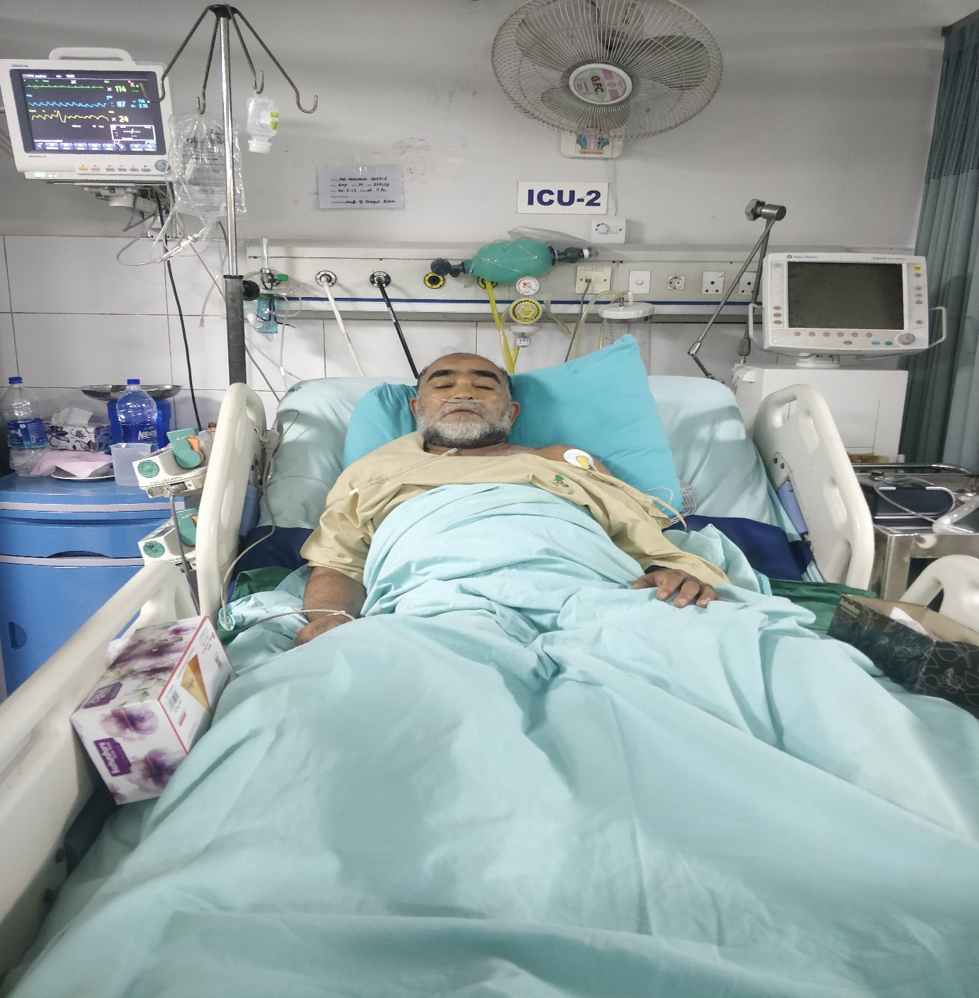

Slide 22
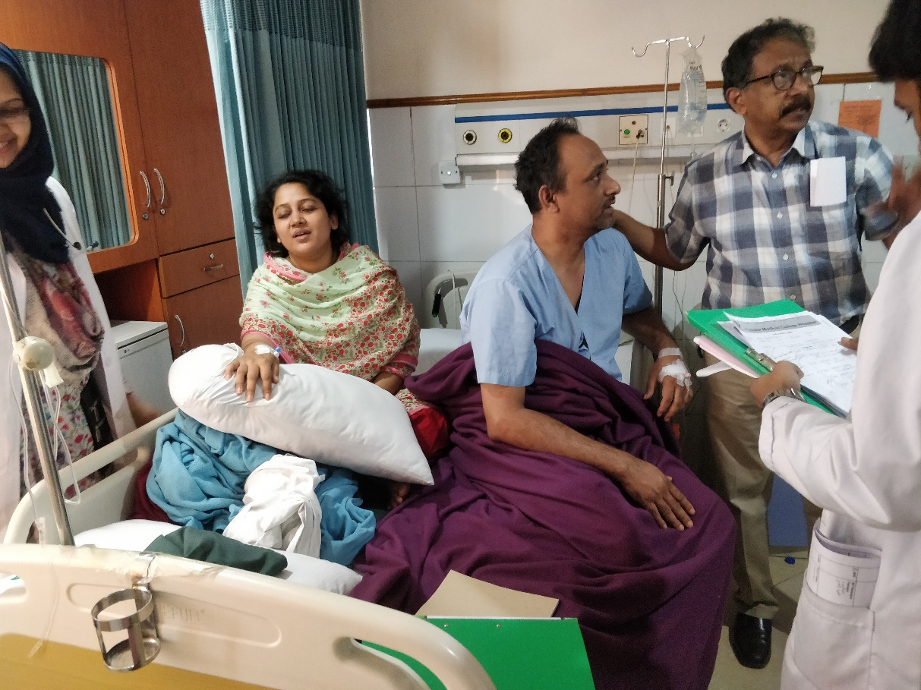
Bed crisis: Dengue Fact
( 3 family member in one cabin)-

Slide 23
Changing Pattern
Dengue fever and dengue hemorrhagic fever epidemiological changes:
The epidemiology of DF/DHF is complex and remains poorly understood. It involves host, viral and vector status that are further influenced by
demographic, economic, behavioral and varied societal factors.

Slide 24

Changing Pattern
1. Changes in human host
  a. Shift in affected‑age group: Clinical DF in adults is rare. However, there is an evidence of increase of dengue incidence in older age groups, and this age shift has been reported in Singapore, Indonesia, Bangladesh and Thailand.
  b. Sex differences
  c. Rural expansion

Slide 25

Changing Pattern
2. Changes in the dengue virus
  a. Virulence affecting severity of the disease
  Sequential infections or secondary infections are important to determine the severity of the disease.
  The infection enhancement contributes to the pattern of variable‑sized outbreaks observed.

Slide 26
Changing Pattern
Studies in Thailand have revealed the following quantum of DHF risk with different sequences of dengue viruses with
DENV‑1/ DENV‑2: 500‑fold,
DENV‑3/DENV‑2: 150‑fold
DENV‑4/DENV‑2 equals to 50‑fold risk.
b. Genotype affecting time interval between sequential infections

Slide 27
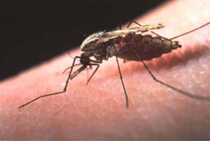
C. Changes In the vector bionomics
Rural spread
Seasonality and climate variability
Socio‑cultural and socio‑economic factors affecting vector longevity and survival

Slide 28
Dengue virus serotype 2 and 3 causing high morbidity and mortality in Swat, Pakistan
Hundreds of people died in the string of dengue epidemics in Pakistan since 2005.
In July 2013, a major outbreak of dengue started in Swat district of Khyber Pakhtunkhwa (KPK) which has so far caused 57 deaths and thousands of morbidities.
366 were found to be serologically positive by the Standard Diagnostics (SD) Dengue Duo test. All dengue virus (DENV)
positive samples were then analyzed using a DENV serotype-specific ( RT- PCR)
DENV serotypes present and to figure out active infections. In this study, 28.69%
(105/366) of the serologically positive patients had active infection and DENV type 3 (DENV-3) was the most abundant serotype followed by DENV-2
Amjad Ali 1,2 Zeeshan Nasim 1, Rafi Ur Rehman 1, Farzana 1, Sajid Ali 3,Fazli Zahir 1,Aqib Iqbal 1, Ijaz Ali 1,4*, Abdul
Biohelikon: Immunity and Diseases , 2013, Vol 1, a6 Research

Slide 29
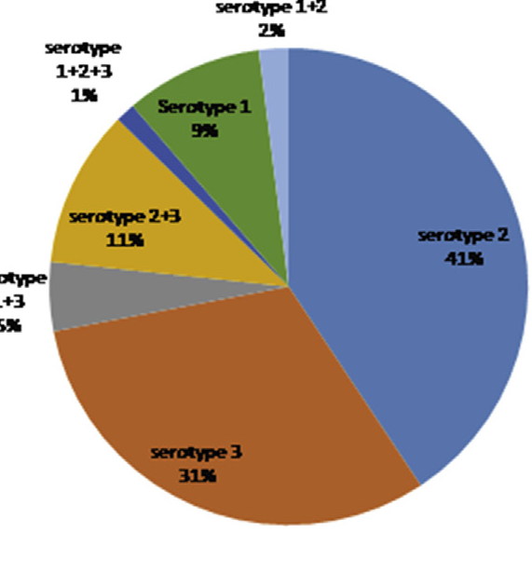
Largest dengue outbreak of the decade with high fatality may be due to reemergence of DEN-3 serotype in Dhaka, Bangladesh, necessitating immediate public health attention
T shirin et al , © 2019 The Author(s). Published by Elsevier Ltd, NMNI, 29, 100511
This is an open access article under the CC BY-NC-ND license (http://creativecommons.org/licenses/by-nc-nd/4.0/).

Slide 30
Last year Out break Observation - 2018
Less rash
Fever persists longer duration
More Leucopenia
High AST
Tourniquet test +ve early
Diarrhea
Pharyngeal congestion
Myocarditis

Slide 31
This year Out break Observation - 2019
Very less Rash .( more convalescent rash)
Fever persists longer duration ( > 5 days )
More Leucopenia ( as low as 2130/mm3)
High AST ( 3123 IU )
High Lipase level
Tourniquet test +ve early ( even during febrile period) but less common
Diarrhea ( Very common )
Abdominal pain
Persisting vomiting

Slide 32
Special observations 2019
Regular laboratory finding:
Ascites ( before critical phase)
Pleural effusion (Invariably in right side)
Encephalopathy
Isolated cranial nerve palsy
Acute renal failure
Splenomegaly
Pneumonitis
Pancreatitis
Pharyngeal congestion
GBS like feature ( hypokalamia must be ruled out due to vomiting)

Slide 33
Data from 150 Patients,2019
Dengue Case Group
Group –A …………. 24.3% (37)
Group – B ………… 57.4 %(86)
Group– C ………… 18.3% (27)
3 cases were in decompensated shock,1 died,2 recovered.

Slide 34
Dengue Case Group (150 data)

Slide 35
Usual / Typical clinical presentations in DF
Sudden onset of very high fever
Moderate to severe body ache
Back pain ( break bone disease )
Prostration/ Fatigue
Eye ball pain ( Retrobulbar )
Headache
Nausea
Rashes 3 types

Slide 36
Clinical Presentations ( Symp/ Sign)
Fever not typical always
Rash (mostly convalescence) …. 29 (19.3%)
Pain abdomen……… 84 (56.7%)
Persisting vomiting ……. 60 (40%)
Loose motion ………. 96 (64%)
Bleeding (Any form)………. 30(20%)
Ascites ……………………….. 102(68%)
Itching ……………………… 42(28%)

Slide 37
Contd.
Pleural effusion ………. 101(66.67%)
Hepatomegaly …………… 72(48.2%)
Splenomegaly ……… 16(10.7%)
Jaundice …………….. 30(20%)
Pneumonia ………. 8 (5%)
Acute renal failure ………… 6(4%)
TT …………. 18(12%)

Slide 38
Investigations
Total count of WBC as low as 1120/ mm3
Lowest Platelet 4000/ mm3
Gall blader thickening/ cholecystitis …… 66(44.3%)
High Lipase (> 500) ………. 36 (23.7%)
High SGOT (> 200) ……………. 112(74.7%) 6531
IgG positive …………. 86(57.5%)

Slide 39
Dengue with Co-infection
Need more documents
Need to find correlation –
1. Enteric Fever
2. Pneumonia
3. UTI
4. Infective diarrhea

Slide 40
Dengue with Splenomegaly
Need to consider-
Enteric Fever
HLH
We got 3 culture positive Enteric Fever out of 16 Splenomegaly cases.

Slide 41
Changing Fever pattern : Onset of afebrile period

Slide 42
About HLH
Haemophagocytic lymphohistiocytosis (HLH) is rare but potentially fatal severe immune activation syndrome caused by proliferation of activated lymphocytes and macrophage which leads cytokine release syndrome.

Slide 43
HLH (Diagnostic Criteria)
Five of the following eight findings:
Fever ≥38.5°C
Splenomegaly
Bicytopenia
Hypertriglyceridemia and/or hypofibrinogenemia
Hemophagocytosis in bone marrow, spleen, lymph node, or liver
Low or absent NK cell activity.
Ferritin >500 ng/mL.
Elevated soluble CD25.
Among above, NK cell activity and CD 25 cell are almost always not available to measure, and often there is lack of evidence of hemophagocytosis in biopsy.

Slide 44
HLH (Treatment)
High dose steroid
Immunoglobulin

Slide 45
HLH Experience
We have got 9 patients out of 16 patients having splenomegaly who fulfill the criteria of HLH and diagnosed as DF with HLH.
Experience:
Longer duration of illness(Increase hospital stay).
Treating as usual protocol with high monitoring of vital signs.
We used oral prednisolone.
No casualty occurred and all patients are now completely fine.(Follow up revealed normal reports.)

Slide 46
Excessive Menstrual Bleeding
Dengue Fever may cause early menstruation / prolongation of menstrual period.
We get better outcome with hormonal therapy.

Slide 47
About NS1
False positive ------- 5%
False negative---- 5%
So, need to more emphasis on clinical presentation
We got 23 dengue patients (NS1 negative)

Slide 48
Blood transfusion
No need of Blood transfusion.
Blood for blood loss
May consider –
. May consider in case of excessive visible bleeding
- Rapid fall of HCT

Slide 49
About Fluid Mx
When Fluid needs rapid correction :
Impending Shock / Shock
High HCT
Narrow pulse pressure (<20)

Slide 50

Platelet transfusion
We did not give platelet transfusion even in platelet 2K/$µ$L.
When may consider-
- H/O Recent surgery with suggestive of concealed/ visible bleeding.
- Dengue Fever with other thrombocytopenic condition Like SLE.

Slide 51
Management highlights
Out of 150 patients
3 patients got Apheretic platelet transfusion
3 patients got whole blood transfusion (menorrhegia 2, GI bleeding 1)
Colloid Infusion – 15 cases ( 10% )
90% management with Crystaloid fluid
1/3rd of patients were managed poor before admission or delayed report to hospital.

Slide 52
Prognosis
Early development of Leucopenia progress to plasma leakage more rapidly and may have a worst course.
HCT > 48 needs urgent fluid management
HCT <30 needs to check internal bleeding
Ig G positive patient may need special consideration.
Dengue fever with leukocytosis need to consider pancreatitis/pneumonia.
Development of Itching suggests recovery.

Slide 53
Alarming for Future
Sensitivity of NS1
Prolonged Loose motions (may lead to irreversible shock.)
Acute renal failure
Co-infection
HLH
Plasma leakage even without fever.

Slide 55

Thank You

